Slide 1
Software Systems Design and Integration
Week 3
Inter-process Communication and Sockets Programming
1-<number>

Slide 2
Lecture Plan
    Inter-process Communication
      Processes and their resources
      Inter-process communications
      Communication models
      Event synchronization
    Middleware and Sockets API
    Java Sockets Programming
    Group Communication using
    Multicasting
1-<number>

Slide 3
What is a Process?
Process – a program in execution (also known as a job)
  There could be multiple copies of the same or different programs running at the same time (multi-tasking)
  There can be multiple subprocesses running as part of each process (multi-processing)
  Each process consists of multiple operations running one after another (sequential execution) or in parallel (concurrent execution)
A process includes:
  operations (code)
  program counter (pointer for tracking the operations)
  stack (temporary data store for calculated values)
  heap (global data store for holding the results)
1-<number>
Notes:
Example: run server program twice. Run jobs and ps

Slide 4
Inter-process Communications (IPC)
Processes communicate through exchanging messages
Operating systems provide facilities for controling interprocess communications (IPC), such as message queues, semaphores, and shared memory.
Software middleware make use of these facilities to provide application programming interface (API), which allows IPC to be programmed at a higher level of abstraction.
Distributed computing requires exchange among independent processes using two essential operations:
  send (message)
  receive (message)
1-<number>
Notes:
Interprocess Communications in Unix, the Nook and Crannies by John Shapley Gray. Prentice Hall.

Slide 5
Connection-oriented IPC
process
p
process
q
send
m
receive
Communication channel
Outgoing message buffer
Incoming message buffer
In connection-oriented IPC, p and q communicate by:
  establishing a communication channel between them (physical session)
  exchanging data via communication protocols
1-<number>

Slide 6
Message-oriented IPC
Process 1
Process 2
Message data
sender
receiver
Communication between processes occurs without resorting to shared memory
Processes exchange discrete messages using send and receive operations
Messages can be exchanged over several sessions
1-<number>

Slide 7
Operations provided in an archetypal Inter-process Communications API
Essential operations
Connect (sender address, receiver address), required for connection-oriented communication.
Send ( [receiver], message)
Receive ( [sender], message)
Disconnect (connection identifier), required for connection-oriented communication.
Optional operations
Request – the client requests connection
Accept – the server accepts the request
1-<number>

Slide 8
IPC Models
In distributed computing, two or more processes engage in IPC in a protocol agreed upon by the processes. A process may be a sender at some points during a protocol, a receiver at other points.
When communication is from one process to a single other process, the IPC is said to be a unicast. When communication is from one process to a group of processes, the IPC is said to be a multicast.
1-<number>

Slide 9
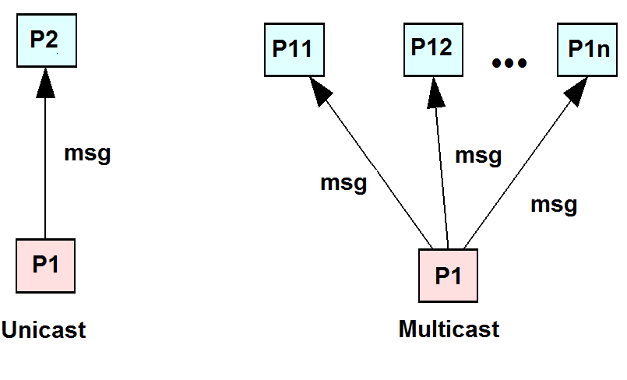
Unicast vs. Multicast
1-<number>

Slide 10
Unicast – TCP/IP vs.UDP/IP
write
read
read
write
TCP/IP - Unicast
?
UDP/IP - Unicast
1-<number>

Slide 11
UDP/IP Unicast
User Datagram Protocol over Internet Protocol
  Sends data in packages
  Each package must have a max size 2¹⁶ bytes = 65,536 bytes
  Might have to chop msg into small pieces and reassemble
  Might be useful for games (few packages lost doesn’t matter)
Quality of Service (QoS)
  Great performance (doesn’t make a lot of checks and retries)
  Messages might be lost
  Don’t know if the message was lost (no confirmation)
  Never get two instances of the same message
  Messages might not arrive in order in which they were sent
1-<number>

Slide 12
TCP/IP Unicast
Transmission Control Protocol over Internet Protocol
  Simulates two streams (from A to B, and from B to A)
  No limit to the size of data being sent (no chunks)
  What is written into a stream at one end is read at the other
Quality of Service (QoS)
  Fair performance (spends time checking and resending)
  Messages are never lost (will be resent on timeout)
  Same message never received twice (duplicates discarded)
  Messages arrives in the exact same order they were sent
  Network/receiver might fail (don’t know if message got there)
  Requires extra communication and consumes caching memory
1-<number>

Slide 13
Synchronous and Asynchronous Operations
IPC operations could be synchronous, i.e. they are executed in a strict order
  The necessary synchronization in such cases is provided by the mechanism of blocking. A blocking operation issued by a process will block further processing of the process until the operation is fulfilled.
IPC operations may also be asynchronous or non-blocking, i.e. execute independently
  An asynchronous operation issued by a process will not block further the process. Instead, it is free to proceed, and may optionally be notified by the system when the operation is fulfilled.
1-<number>

Slide 14
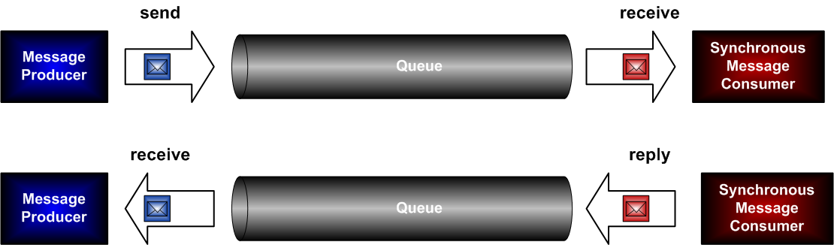
Synchronous Messaging
All messages are exchanged within one single session of communication
Stateful protocol needed (based on TCP sockets, IIOP, or similar – i.e., FTP, CORBA, RMI, RTP,etc.)
Communication channel occupied during the entire session
Very simple on both client-side and server-side

Slide 15
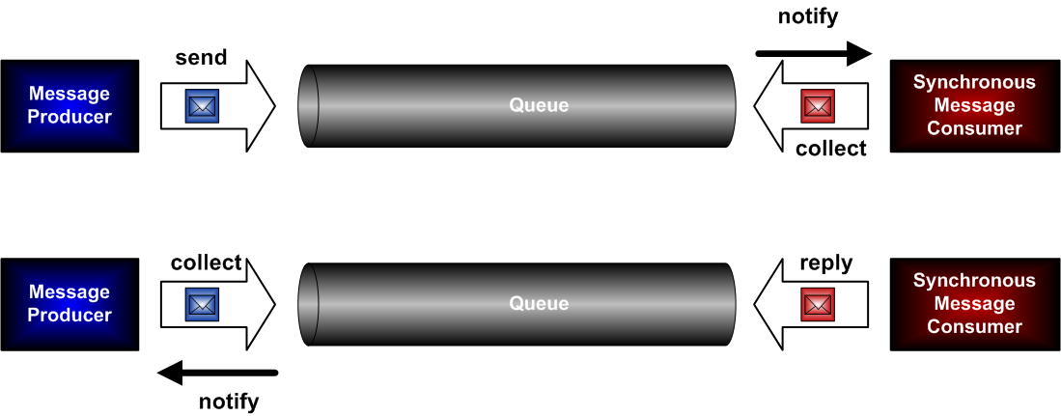
Asynchronous Messaging
6 separate sessions for exchanging all messages
No need for stateful protocol, so any stateless protocol without session support can be used (based on UDP sockets, or similar - i.e., SMS, SNMP, MQ, SQS, etc.)
Notification mechanism needed on both sides (PUSH)

Slide 16
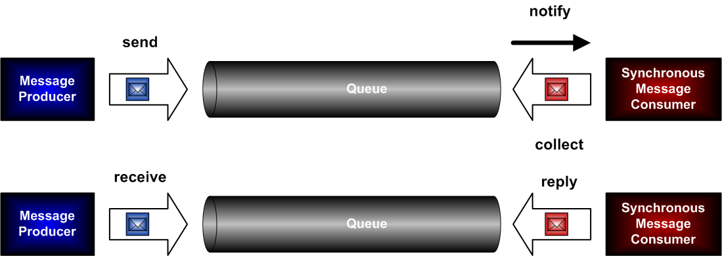

Combined Synchronous/Asynchronous Messaging
Several (5) different sessions for exchanging the messages
Notification mechanism needed only on server-side
Very simple client – just send and receive methods

Slide 17
Synchronisation
IPC require that the two communicating processes synchronize their operations: one side sends, then the other receives until all data has been sent and received.
  Ideally, the send operation starts before the receive operation commences (event synchronization)
  In practice, the synchronization requires additional system support (process start and finish synchronization and data access control)
1-<number>

Slide 18
Lecture Plan
    Inter-process Communications
      Processes and their resources
      Inter-process communications and protocols
      Communication models
      Event Synchronization
    Middleware and Sockets API
      Middleware Layers
      Java Sockets API
    Java Sockets Programming
    Group Communication using Multicasting
1-<number>

Slide 19
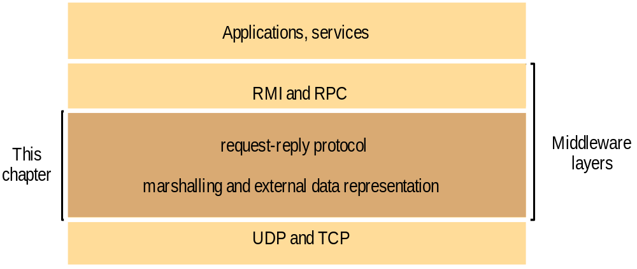
Middleware layers
1-<number>

Slide 20
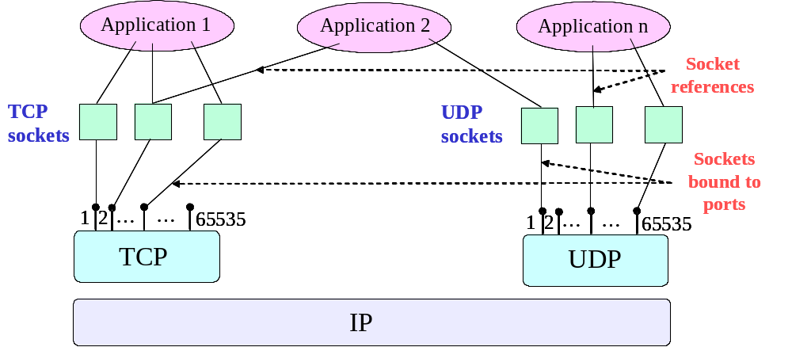
TCP/UDP Sockets and Ports
1-<number>

Slide 21
Communicating over Sockets
any port
agreed port
socket
socket
message
client
server
other ports
Internet address = 138.37.94.248
Internet address = 138.37.88.249
1-<number>

Slide 22
Java Sockets API
Socket API is build into the core of Java SE
  The Socket API is in the Java SE package java.net
  It uses also classes from Java SE package java.io
Can be used for programming distributed applications on different platforms
  for desktop computers (Windows, Mac and Unix),
  embedded devices
  wireless Internet applications on smartphones (Android, iOS and Symbian)
1-<number>

Slide 23
API Class | Use | Parameters
ServerSocket | Creating server socket for TCP communication | TCP/IP Port No. [only for server]
Socket | Creating Client socket for TCP communication | Server Host IP TCP/IP Port No.
DataInputStream | Associating a binary input stream with a TCP socket | Stream
DataOutputStream | Associating a binary output stream with a TCP socket | Stream
DatagramSocket | Creating a socket for UDP communication | TCP/IP Port No. [if server]
DatagramPacket | Creating a placeholder for the data in UDP communication | Binary Data Vector Vector Length Host IP and TCP/IP Port No. [if client]
1-<number>

Slide 24
Lecture Plan
    Inter-process Communication
      Processes and their resources
      Inter-process communications and protocols
      Communication models
      Event Synchronization
    Middleware and Sockets API
      Middleware Layers
      Java Sockets API
    Java Sockets Programming
      TCP Sockets
      UDP Sockets
    Group Communication using Multicasting
1-<number>

Slide 25
Example: TCP client connects to a server, sends a request & receives a reply
import java.io.*;
import java.net.*;
class TCPClient {
public static void main (String[] args) throws Exception {
/* CREATING DATA BUFFERS */
String sentence;
String modifiedSentence;
/* IDENTIFYING THE SERVER */
InetAddress host = netAddress.getByName(args[0]);
/* OPENING THE COMMUNICATION CHANNEL */
Socket clientSocket = new Socket(host, 6789);
/* PREPARING THE INPUT AND THE OUTPUT STREAMS */
BufferedReader inFromUser =
new BufferedReader(new InputStreamReader(System.in));
DataOutputStream outToServer = new DataOutputStream
(clientSocket.getOutputStream());
BufferedReader inFromServer = new BufferedReader
(new inputStreamReader
(clientSocket.getInputStream()));
1-<number>

Slide 26
(cont.)
/* SENDING DATA */
sentence = inFromUser.readLine();
outToServer.writeBytes(sentence +'\n');
/* RECEIVING DATA */
modifiedSentence = inFromServer.readLine();
System.out.println("FROM SERVER: " + modifiedSentence);
/* CLOSING THE COMMUNICATION CHANNEL */
clientSocket.close();
}
}
1-<number>

Slide 27
Example: TCP server accepts connections and processes client’s request in a loop
import java.io.*;
import java.net.*;
class TCPServer {
public static void main (String[] args) throws Exception {
/* CREATING DATA BUFFERS */
String clientSentence;
String capitalisedSentence;
/* OPENING THE COMMUNICATION CHANNEL */
ServerSocket welcomeSocket = new ServerSocket(6789);
while(true) {
/* ACCEPTING A CLIENT REQUEST */
Socket connectionSocket = welcomeSocket.accept();
/* PREPARING THE INPUT AND THE OUTPUT STREAMS */
BufferedReader inFromClient = new BufferedReader (
new InputStreamReader (connectionSocket.getInputStream()));
DataOutputStream outToClient =
new DataOutputStream (connectionSocket.getOutputStream());
/* RECEIVING THE CLIENT REQUEST AND PROCESSING THE DATA*/
clientSentence = inFromClient.readLine();
capitalisedSentence = clientSentence.toUpperCase() + '\n';
/* SENDING THE RESPONSE TO THE CLIENT*/
outToClient.writeBytes(capitalisedSentence +'\n');
}
}
}
1-<number>

Slide 28
Example: UDP client sends a message to the server and gets a reply
import java.io.*;
import java.net.*;
class UDPClient {
public static void main (String[] args) throws Exception {
/* CREATING DATA BUFFERS */
String sentence;
String modifiedSentence;
/* IDENTIFYING THE SERVER*/
InetAddress host = InetAddress.getByName(args[0]);
/* OPENING THE COMMUNICATION CHANNEL */
DatagramSocket clientSocket = new DatagramSocket();
/* PREPARING THE OUTPUT DATA BUFFER */
BufferedReader inFromUser = new BufferedReader
(new InputStreamReader(System.in));
byte[] sendData = new byte[1024];
sentence = inFromUser.readLine();
sendData = sentence.getBytes();
1-<number>

Slide 29
(cont.)
/* PREPARING THE INPUT DATA BUFFER*/
byte[] receiveData = new byte[1024];
/* CREATING THE OUTGOING PACKET */
DatagramPacket sendPacket = new DatagramPacket
(sendData, sendData.length, host, 9876);
/* SENDING THE REQUEST TO THE SERVER */
clientSocket.send(sendPacket);
/* PREPARING THE INCOMING PACKET */
DatagramPacket receivePacket = new DatagramPacket
(receiveData, receiveData.length);
/* RECEIVING THE RESPONSE FROM THE SERVER */
clientSocket.receive(receivePacket);
/* EXTRACTING THE RESPONSE FROM THE PACKET */
modifiedSentence = new String(receivePacket.getData());
System.out.println("FROM SERVER: " + modifiedSentence);
/* LEAVING THE COMMUNICATION CHANNEL */
clientSocket.close();
}
}
1-<number>

Slide 30
Example: UDP server receives messages and responds to client
import java.io.*;
import java.net.*;
class UDPServer {
public static void main (String[] args) throws Exception {
/* CREATING DATA BUFFERS */
String sentence;
String capitalisedSentence;
/* CREATING COMMUNICATION CHANEL */
InetAddress host = null;
int port;
/* OPENING THE COMMUNICATION CHANEL */
DatagramSocket serverUDPSocket = new DatagramSocket(9876);
byte[] sendData = new byte[1024];
byte[] receiveData = new byte[1024];
1-<number>

Slide 31
(cont.)
while(true) {
/* PREPARING THE PACKET FOR HOLDING THE REQUEST OF A CLIENT */
DatagramPacket receivePacket =
new DatagramPacket (receiveData, receiveData.length);
/* RECEIVING A REQUEST AND EXTRACTING THE DATA INTO THE PACKET */
serverUDPSocket.receive(receivePacket);
sentence = new String(receivePacket.getData());
/* IDENTIFYING THE CLIENT */
host = receivePacket.getAddress();
port = receivePacket.getPort();
/* PROCESSING THE REQUEST AND CREATING A RESPONSE */
capitalisedSentence = sentence.toUpperCase();
sendData = capitalisedSentence.getBytes();
/* PACKING THE RESPONSE AND SENDING THE PACKET TO THE CLIENT */
DatagramPacket sendPacket = new DatagramPacket
(sendData, sendData.length, host, port);
serverUDPSocket.send(sendPacket);
}
}
}
1-<number>

Slide 32
IP Multicasting
Establish network of peers
  The network uses class D address (the first four bits are 1110 in IPv4)
  Multicast address allocation can be permanent or temporary:
    no central registry
    time to live (TTL) limits the # of hops, hence distance
    tools like session directory can help manage multicast addresses and find new ones
Use UDP/IP as a transport protocol
  Peer joins a group via socket bound to the multicast address
  Msgs are delivered to the sockets of all peers in the group
Routing the messages to out-going links may be enhanced using multicast routers which broadcast messages to the peers
1-<number>

Slide 33
IP Multicast implementation based on UDP
?
IP Multicast
?
?
?
1-<number>

Slide 34
IP Multicast Reliability and Ordering
Inherits UDP-level reliability: missing messages, out-of-order messages ...
Effects on
  fault tolerance based on replicated services
    ordering of the requests might be important, servers can be inconsistent with one another
  discovering services
    not too problematic
  better performance through replicated data
    loss and out-of-order updates could yield inconsistent data, sometimes this may be tolerable
  event notification
    not too problematic
1-<number>

Slide 35
Multicast peers communicating using datagrams
A multicast group is specified by a class D IP address and by a standard UDP port number. Class D IP addresses are in the range 224.0.0.0 to 239.255.255.255, inclusive. The address 224.0.0.0 is reserved and should not be used.
import java.net.*;
import java.io.*;
public class MulticastExample{
public static void main(String args[]){
// join a Multicast group and salutate
...
String msg = "Hello";
InetAddress group = InetAddress.getByName("228.5.6.7");
MulticastSocket s = new MulticastSocket(6789);
s.joinGroup(group);
DatagramPacket hi = new DatagramPacket(msg.getBytes(),
msg.length(), group, 6789);
s.send(hi);
// get their responses!
byte[] buf = new byte[1000];
DatagramPacket recv = new DatagramPacket(buf, buf.length);
s.receive(recv);
...
// OK, I'm done talking - leave the group
...
s.leaveGroup(group);
1-<number>

Slide 36
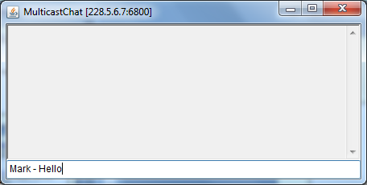
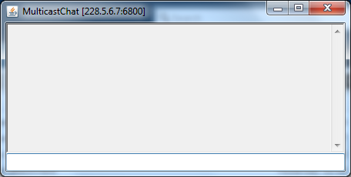
Example: IP Multicast

Slide 37
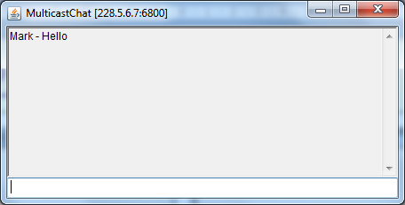
Example: IP Multicast

Slide 38
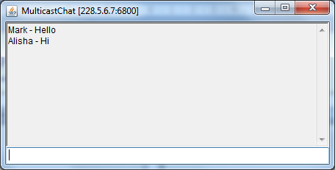
Example: IP Multicast

Slide 39
Lecture Summary
  What we have covered in this lecture:
  Inter-process Communications
  Middleware and Sockets API
  Java Sockets Programming
  Multicast Group Communication
  Next lecture will cover:
  External Data Representation
1-<number>

